Slide 1




THREAT MODELING
Presenting By,
BHANDHAVYA

Slide 2





TOPICS ARE:
01
02
03
Threat Model Ranking
Threat Model Execuption Phases
Threat Traceability Matrix

Slide 3





01
Threat model
Ranking

Slide 4

What it mean
During software design, threat modeling helps find the most important parts of your system or app. It checks for possible dangers to those parts. It then ranks those threats based on how much damage they could cause to your business.

Slide 5
1. DREAD METHOD
Letter | Meaning | What It Checks
D | Damage | How bad would the attack be if it happened?
R | Reproducibility | Can the attack be repeated easily?
E | Exploitability | How easy is it to carry out the attack?
A | Affected Users | How many people would be impacted?
D | Discoverability | How easy is it to find the weakness or vulnerability?

Slide 6
2. CVSS METHOD(Common Vulnerability Scoring System)
CVSS is a standard way to measure how serious a security vulnerability is. It gives each threat a score from 0 to 10, where 10 means the most critical
CVSS considers things like:
-How easy is it to exploit the threat?
-Does it require user interaction?
-How does it affect the system—confidentiality, Integrity, availability?
-Is the threat local or can it be done remotely?

Slide 7
3. CWSS METHOD (Common Weakness Scoring System)
CWSS stands for Common Weakness Scoring System. It is used to measure the severity(dangerous) of software weaknesses.
CWSS considers factors like:
Business Impact: How does the weakness affect the organization?
Likelihood of Exploit: How likely is it that someone (like a hacker) will find and use the weakness to attack the system? Technical Impact: What damage can the weakness cause to the system?
CWSS scores help organizations focus fixing weakness that pose the greatest risk to their operations

Slide 8


02
Threat Model Excution Phases

Slide 9
What is Threat modeling Phases
A threat modeling diagram is a visual tool used to map out how a system works and where potential security threats might arise. It helps teams understand the flow of data, identify weak points, and plan defenses before attackers can exploit them

Slide 10

How do yo create a threat model diagram
🛠️ Steps to Create a Threat Model Diagram: 1 .Define the Scope.
- Decide what system, app, or feature you're modeling.
- Identify assets you want to protect (e.g., user data, credentials).
2 .Choose a Diagram Type.
- Most commonly used: Data Flow Diagram (DFD)
- Others include Process Flow Diagrams or Attack Trees

Slide 11
3 .List System Components.
- External entities (users, third-party services)
- Processes (functions, APIs, services)
- Data stores (databases, file systems)
- Data flows (how data moves between components)
4 .Draw the Diagram.
- Use symbols: circles for processes, rectangles for entities, open-ended rectangles for data stores, arrows for data flow.

Slide 12
5 .Identify Threats.
- Apply models like STRIDE, DREAD, or CVSS to each component and data flow.
- Ask: What could go wrong here? Who might exploit it?
6.Review and iterate.
- Validate with your team.
- Update the diagram as the system evolves.

Slide 13
Five Threat modeling steps
🛠️ 1 .Define Security Requirements
- Understand what you're protecting and why
- Set goals like confidentiality, integrity, and availability
Example: “User data must be encrypted at store and in move”
🧭 2 .Create an application Diagram.
- Map out your system visually
- Include external entities, processes, data stores, and data flows
- Helps you see how everything connects and where threats might sneak in

Slide 14
⚠️ 3. Identify Threats
- Use models like STRIDE or DREAD to spot potential risks
- Think like an attacker to uncover weak spots
🛡️ 4. Mitigate Threats
- Plan defenses for each threat you found
Examples: input validation, encryption, access controls etc.

Slide 15
✅ 5. Validate and Review
-Test your mitigations—did they actually fix the problem?
-Update your threat model as the system evolves
-Make this a regular part of your development cycle

Slide 16

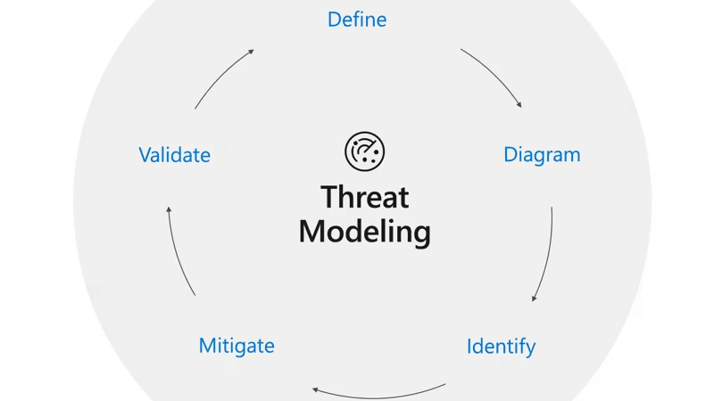

Slide 17
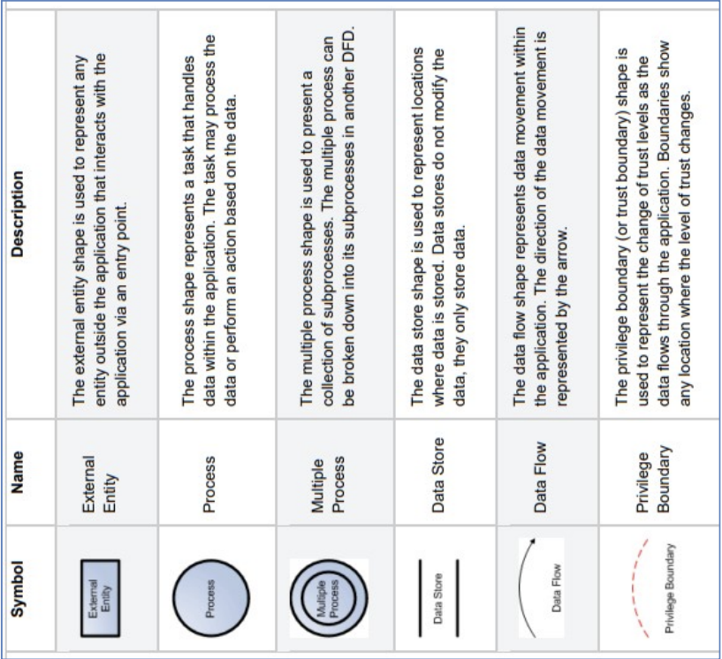
There are a number of symbols that are used in DFDs for threat modelling

Slide 18
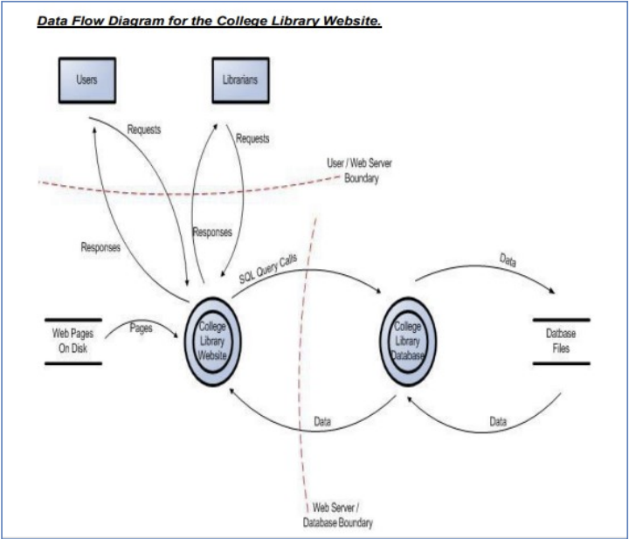

Slide 19



03
Threat Tracebility Matrix

Slide 20
What is Threat Traceability matrix?
A Threat Traceability Matrix (TTM) is a structured security tool used to map and trace potential threats to a system or application. It helps identify how a threat agent can attack a system, what assets are at risk, how the attack may happen, and what controls should be applied to reduce the risk.

Slide 21
Column | Purpose
THREAT AGENT | Identifies the source of the threat (e.g., attacker type or reference ID)
ASSET | Defines the target being attacked (e.g., credentials, services, data)
ATTACK | Describes the method used (e.g., brute force, phishing etc.)

Slide 22
ATTACK SURFACE | Pinpoints the vulnerable interface or entry point (e.g., login fields)
ATTACK GOAL | States the attacker's objective (e.g., data theft, privilege escalation)
IMPACT | Rates the consequence if successful (e.g., financial loss, system compromise)
CONTROL MITIGATION | Outlines current defenses or gaps in protection (e.g., policies, detection tools)

Slide 23
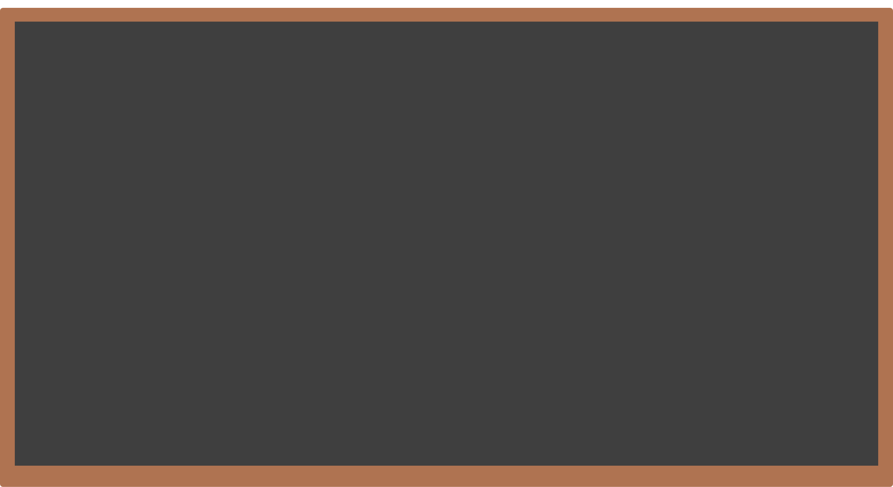





Thank
you!

